Slide 1
BSc I YEAR
CHEM 101
SECTION D
ALKENES

Slide 2
ALKENES
Unsaturated aliphatic hydrocarbons containing two hydrogen atoms less than the corresponding alkanes and which are characterized by the presence of a double bond in their molecules are called alkenes. These are also called olefins. The general formula of alkenes is CnH2n where n = 4, 5, 6 ..... etc.
COMMON AND IUPAC NAMES
Common names: Alkane-ane + ylene = Alkylene
IUPAC names: Alkane-ane + ene = Alkene
Alkenyl groups: The monovalent alkenyl group obtained by removing a hydrogen atom from ethylene
Is called venyl group or ethenyl group and that derived from propylene by removing a hydrogen atom from the doubly bonded carbon atoms is called propenyl group. If, however, a hydrogen atom 1s removed from the methyl group of propylene, the alkenyl group is called allyl group.

Slide 3

Examples

Slide 4
METHODS OF PREPARATION OF ALKENES
1. Dehydrohalogenation of alkyl halides:
The removal of the elements of hydrogen halides (HCl, HBr or HI) from the adjacent carbon atoms of an alkyl halide with a strong base such as sodium ethoxide or a concentrated alcoholic solution of potassium hydroxide is called dehydrohalogenation.

Slide 5
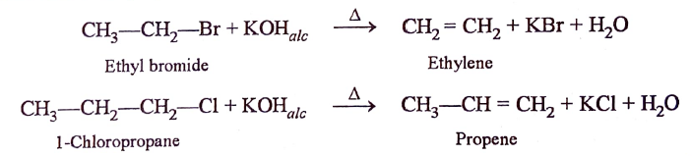
Dehydrohalogenation of alkyl halides:

Slide 6
MECHANISM:
E1 (Elimination, bimolecular) reaction
Dehydrohalogenation of alkyl halides is an example of elimination reactions. Elimination reactions occur by a number of different mechanisms but we shall discuss here only two of them, i.e., E2and E1.
Kinetic studies of this reaction reveal that the reaction follows second-order kinetics, i.e. , the rate of the reaction is proportional to the concentration of both the alkyl halide and the base,
Rate α [Alkyl halide] [Base]

Slide 7
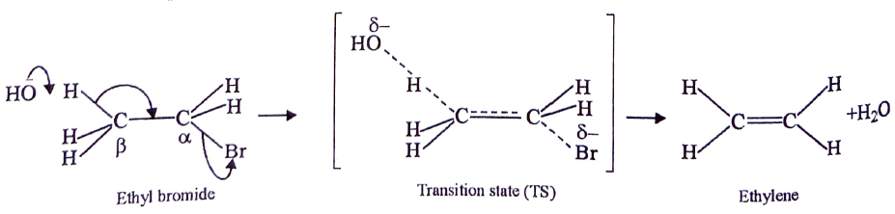
E2 MECHANISM

Slide 8
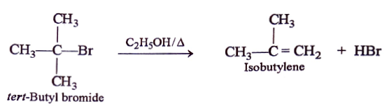
E1 MECHANISM

Slide 9
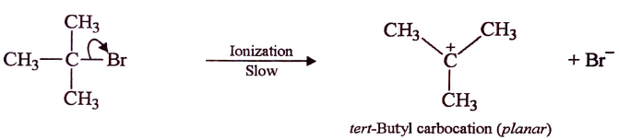
E1 mechanism step 1

Slide 10
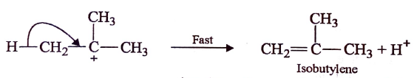
E1 -STEP 2 (Write few lines on this step)

